Slide 1
VOYAGE EXTATIQUE
Your travel buddy is here.

Slide 2
WHAT EXACTLY IS VOYAGE EXTATIQUE
It is your travel buddy to make your pre-trip planning and research a piece of cake.

Slide 3
WHAT IS THE NEED OF THIS APP
Everyone wishes to travel to a dream destination and savour the eternal beauty of that place and dive into ecstacy. However, the tiresome job of planning this trip always acts as obstacle in this dream.
But that won’t be the case in the near future as we bring forward your travel buddy The “voyage extatique” that would take on this cumbersome task of pre-trip planning so that you could solely focus on realising your travel fantasies.

Slide 4
WHAT IS IN IT FOR YOU
A personalised account for you to store all your preferences and best journeys.
The option to select any place from the world map.
Reviews and experiences of the travellers about your dream destination.
Amazing UI for once in a lifetime experience.
Display pictures and weather conditions of each destination.

Slide 5
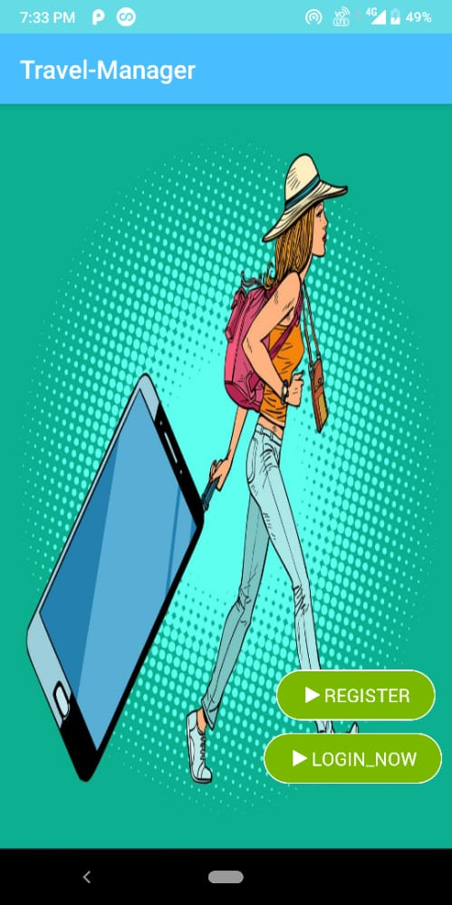
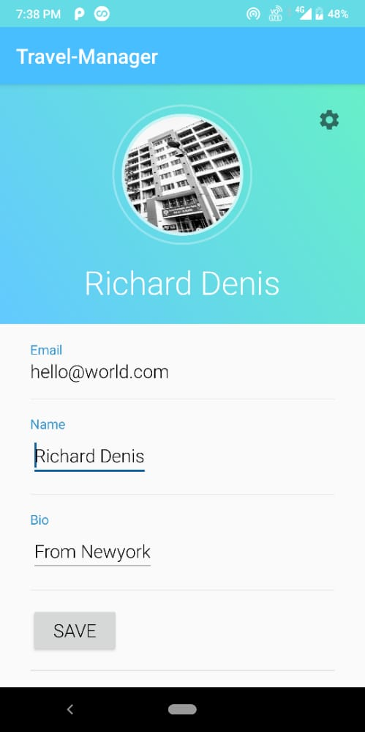
SOME GLIMPSES

Slide 6
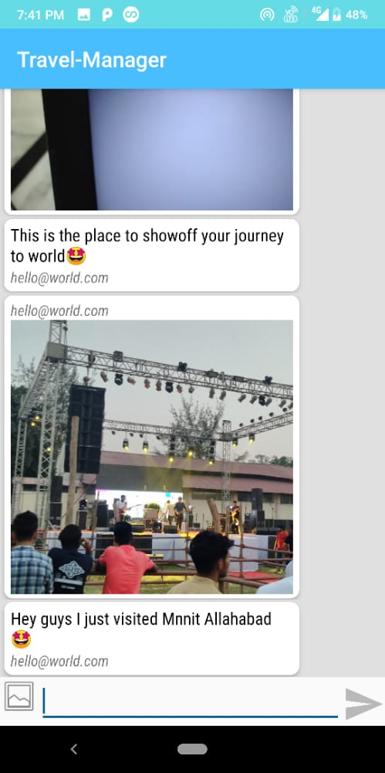
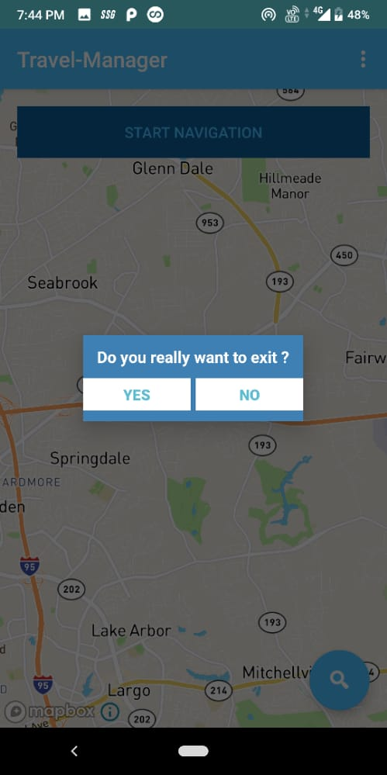

Slide 7

GLIMPSE OF THE NAVIGATION

Slide 8
WHY WORK ON A TRAVEL MANAGER
The biggest desire that haunts our minds amidst this pandemic is to move out of our residence and travel around freely.
Our team WAForever is no exception in this regard and hence this desire to travel freely again motivated us to work on this venture.

Slide 9
SCALABILITY / MARKET SIZE
As mentioned previously, since the desire to travel again is not a rarity, the market for our app would boom after the pandemic.
Since it would be quite important to boost the degrading economy after the pandemic is over, the ministry of tourism is most likely to support startups and ventures that could help in the same.
Thus the ministry of Tourism could act as a potential source of income for our app.
Besides this several investors would also be interested to invest in the tourism field as would be quite profitable by then.

Slide 10
Besides this introducing advertisements could also act as an important source of revenue.
However, we would resist advertisements before the app makes a big hit ☺.

Slide 11
POTENTIAL COMPETITITORS
Several travel apps like makeMyTrip, ixigo, etc., are the potential competitors for our app.
However, our USP of providing many functionalities like navigation , location search , travel guidance etc., all encapsulated in a single app would help us stand out.
Besides the famous ventures in the markets, several new startups can also pose a threat to our growth since several like minded people would try to exploit the growing market.
But we are postive about the fact that our app would definitely make a mark of its own.

Slide 12
FEATURES IN FUTURE
Ticket booking.
Trains/planes tracking
AI predictions of best dates to book a trip (based on weather conditions, ticket prices, etc..).
Employement portal for guides (where guides can apply and tourists can book them).

Slide 13
USP
Most of the important features encapsulated in a single app so that you don’t need to hop from one app to another to meet your service expectation.
Privacy and security ensured.

Slide 14
THANK YOU ☺

